Slide 1
Investment Case Study
Spark Funds

Slide 2
Strategy and Business Objectives
Business Objective
Identify the most suitable funding type, countries and sectors for investments for Spark Funds
Strategy
Spark Funds wants to invest where most other investors are investing
Constraints
Spark funds wants to invest between 5 and 15 million USD per round of investment
It wants to invest only in English-speaking countries because of ease of communication

Slide 3
Data - Investments in 66,368 Companies (1960 – 2015)
Data
66,368 companies across 137 countries
Approx. 1,15,000 funding rounds
8 unique sectors such as social, finance, analytics, advertising, cleaning/semiconductor, etc.

Slide 4
Funding Types, Countries and Sectors
The analysis is divided into three parts:
Given the constraints, which funding type is the most suitable?
In the chosen funding type, which countries have witnessed the most funding?
In the chosen funding type and top countries, which sectors have performed the best?

Slide 5
Funding Types
Given the budget constraint, which funding type is the most suitable?
In the chosen funding type, which countries have witnessed the most funding?
In the chosen funding type and top countries, which sectors have performed the best?

Slide 6
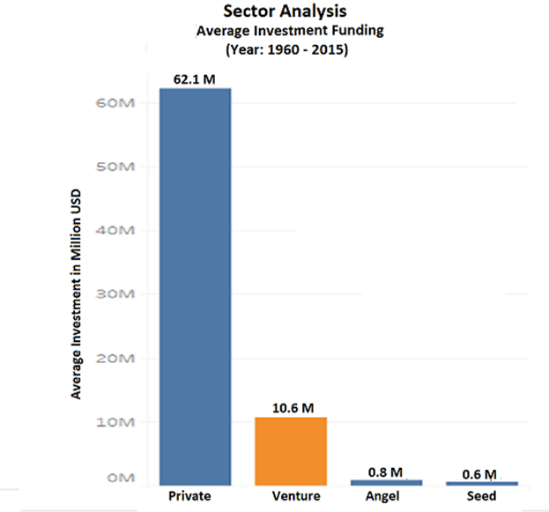
Finding Data
Average Funding Amount in Venture is ~ 10M USD
Venture is the most suitable type for investment
between 5M – 15M USD
Average investment is approx. 10M USD

Slide 7
Top Countries for Venture Capital Investments
Given the budget constraint, which funding type is the most suitable?
In the chosen funding type, which countries have witnessed the most funding?
In the chosen funding type and top countries, which sectors have performed the best?

Slide 8
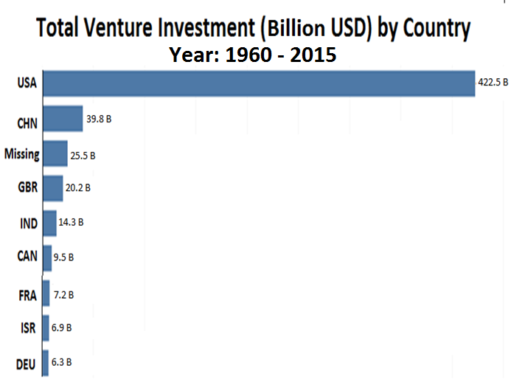
Top Venture Countries – USA, GBR and India
Finding Data
The USA has seen the highest total
investments in venture capital, followed by
the Great Britain and India*
*
China is not an English speaking country
Missing represents unavailable country information

Slide 9
Top Venture Sectors in USA, GBR, IND
Given the budget constraint, which funding type is the most suitable?
In the chosen funding type, which countries have witnessed the most funding?
In the chosen funding type and top countries, which sectors have performed the best?

Slide 10
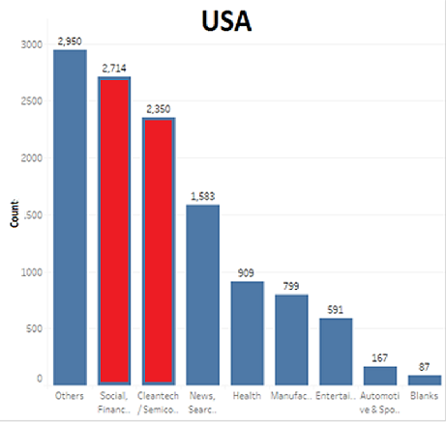
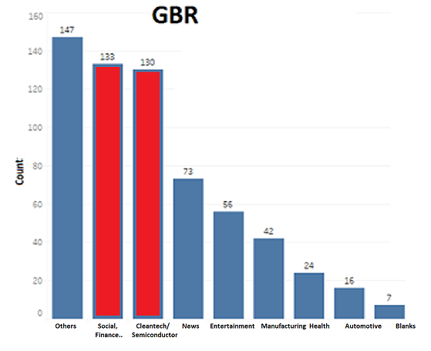
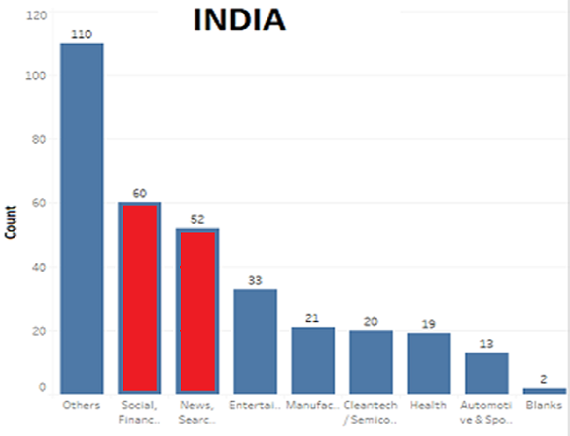
Best Sector – Social, Finance, Analytics, Advertising
Finding Data
USA
Social, Finance, Analytics and Advertising
Cleaning & Semiconductor
GBR
Social, Finance, Analytics
and Advertising
Cleaning & Semiconductor
IND
Social, Finance, Analytics
and Advertising
News, Search and Messaging

Slide 11
Conclusion
Venture capital is the most suited funding type
The USA, the Great Britain and India are the most heavily (venture capital) funded countries
The top two (venture capital) sectors in the respective countries are:

